Slide 1
Dichotomous key
Series of questions that allow biologists to identify unknown organisms.
These questions answerable by looking at the organism picture
Dichotomous key - means dividing into two branches and refers to the fact that you have two description to choose from at each step .
A key is away of leading you through to the name of your organism by giving you 2 description at a time , and you have to choose between them
Each choice you make then leads you on to another pairs of description
Until you end up with the name of your organism

Slide 2
Simple key
Think about these notes
1- does the specimen have wings
2- does the specimen have feathers
3- does the specimen lay eggs
Which question do u think would be most useful for placing an organism in the bird group, and why ?

Slide 3
1- you have to answer yes or no
2- then you have to follow the instruction in front of the sentence

Slide 4
Constructing a Dichotomous Key

Slide 5
Using a Dichotomous Key
Study the organisms that will be classified. Choose one
Read the first set of choices in the dichotomous key
Decide which characteristic the organism has
Follow the numbered items in the key and name the organism

Slide 6




1. a. wings covered by an exoskeleton ----- go to step 2
b. wings freely observed –---- Go to step 3
2. a. body has a round shape ----- ladybug
b. body has an elongated shape ----- grasshopper
3. a. wings point out from the side of the body ------ dragonfly
b. wings point to the posterior of the body ------ housefly

Slide 7
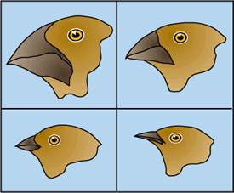
An Example
 |  |  | Finch Identification
1. | a. The beak is relatively long and thin. |  | Certhdea sp.
 | b. The beak is relatively thick and heavy. |  | Go to set 2
2. | a. The bottom surface of the lower beak is flat and straight. |  | Geospiza sp.
 | b. The bottom surface of the lower beak has a bend |  | Go to set 3
3. | a. The lower edge of the upper beak has a distinct bend. |  | Camarhynchus sp.
 | b. The lower edge of the upper beak is mostly flat. |  | Platyspiza sp.

Slide 8
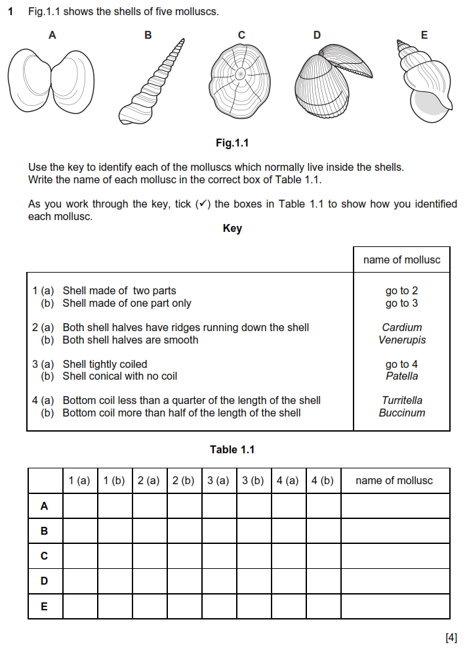
Simple keys

Slide 9
Homework
Create a dichotomous key for the flowers on page 16 fig.1.23

